Slide 1

USABILITY?
TESTING
website:https://www.qunar.com/
Advised by Prof.Qin Liu
Group 16:
2152085 Yifei Sun
2151409 Yuntao Hu
2054099 Jieying Ye
2152193 Yixin Li

Slide 2
Selected Scenario
Xiao Wang, a student at Tongji University, plans to visit Ningbo, Zhejiang, for a three-day trip during the May Day holiday. He has already booked his train tickets and now needs to book a hotel using Qunar. Xiao Wang is looking for a hotel that provides free Wi-Fi and breakfast. He prefers the hotel to be centrally located to ensure easy access to various attractions. He aims to compare different hotels' prices and amenities to find the most suitable option. His priorities include convenience in transportation and good service to make the most of his short vacation.

Slide 3
1.Purpose/Primary goals
2.Constraints and opportunities
3.Questions for the evaluation-objectives
4.How to answer questions
（1）Feature Checklist
（2）Heuristic evaluation
（3）Cognitive walkthrough
（4）Incident Diaries
（5）Field Observation
（6）System Usability Scale
（7）Unstructured Interview
CONTENTS
CONTENTS

Slide 4
01
Purpose/Primary goals

Slide 5

01Purpose/Primary goals
For our usability testing project on Qunar, the primary goal is to improve product usability.
This involves conducting tests with participants who represent the real user base of the website.
These participants will engage in realistic tasks that are typical of user interactions with the site.
Throughout the testing session, careful observation of both the actions and verbal feedback of the participants is essential.
After collecting the data, the next steps include a thorough analysis to identify usability issues, diagnosing specific problems, and making well-informed recommendations for necessary changes to enhance the overall user experience and interface efficiency.

Slide 6
01Purpose/Primary goals
Detailed Goal | Description
Effectiveness | Manage order(Cancel/Modify)/Contact customer service
Efficiency | Return searching results/Booking and purchase process should be simple and smooth
Safety | Information privacy protection/Secure payment methods/Third-party travel agency credibility
Utility | Suitable recommendation/Planning or guide/Reliable comments
Learnability | Get-started document/Clear interface
Memorability | Fixed workflow/User data and history

Slide 7
02
Constraints and opportunities

Slide 8
02Constraints and opportunities
Ubiquitous Accessibility：
Qunar's software can be accessed on multiple platformsallowing users to participate in testing remotely.
Large diverse user base
Qunar has a large user database,including people of different ages, genders, and cultural backgrounds. Testers can leverage these different user characteristics to test scenario compatibility and usability.
Lack of Domain Experts
The absence of domain experts in the testing team may limit understanding of travel-specific requirements and reduce the effectiveness of the test.
Balancing Interests
There is a challenge in balancing corporate goals, such as profitability, with the public's interest in obtaining the best possible travel deals.
Notes:
allowing users to participate in testing remotely, thus eliminating the need for physical presence.

Slide 9
03
Questions for the evaluation-objectives

Slide 10
03Questions for the evaluation-objectives
Effectiveness: the accuracy and completeness with which
users achieve specified goals
Efficiency: the resources expended in relation to the
accuracy and completeness with which users achieve goals
Satisfaction: freedom from discomfort, and positive attitude
to the use of the product
Safety and so on...
Evaluation Objectives

Slide 11
03Questions for the evaluation-objectives
Question
Can Qunar cater to users with different backgrounds?
Can the user see that progress is being made towards their goal?
Is the booking process on Qunar intuitive, allowing users to complete reservations quickly?
Does Qunar provide detailed and up-to-date information about hotels?
......

Slide 12
04
How to answer questions

Slide 13
04How to answer questions
(1)Feature checklists(Empirical)
Approach to answering questions
Feature checklists are structured lists used to record and track tested functionalities.
It's a structured list that includes the functionalities that need to be verified, detailed descriptions of each feature, and related testing steps.
Tasks and Data needed
Methods to be used
Report and Results

Slide 14
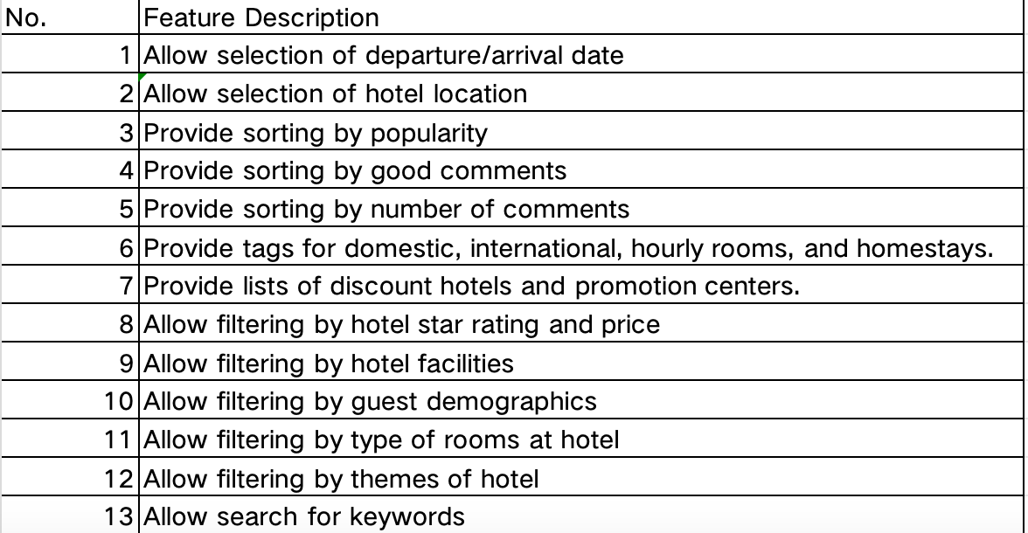
04How to answer questions
(1)Feature checklists(Empirical)
Approach to answering questions
Tasks and Data needed
Methods to be used
Report and Results

Slide 15
04How to answer questions
(1)Feature checklists(Empirical)
Approach to answering questions
Ask users to use Qunar
Let testers use the software to simulate hotel bookings according to selected test scenario.
Distribute questionnaires
For each feature, ask testers to fill out whether they have used or noticed these features.
Tasks and Data needed
Methods to be used
Report and Results

Slide 16
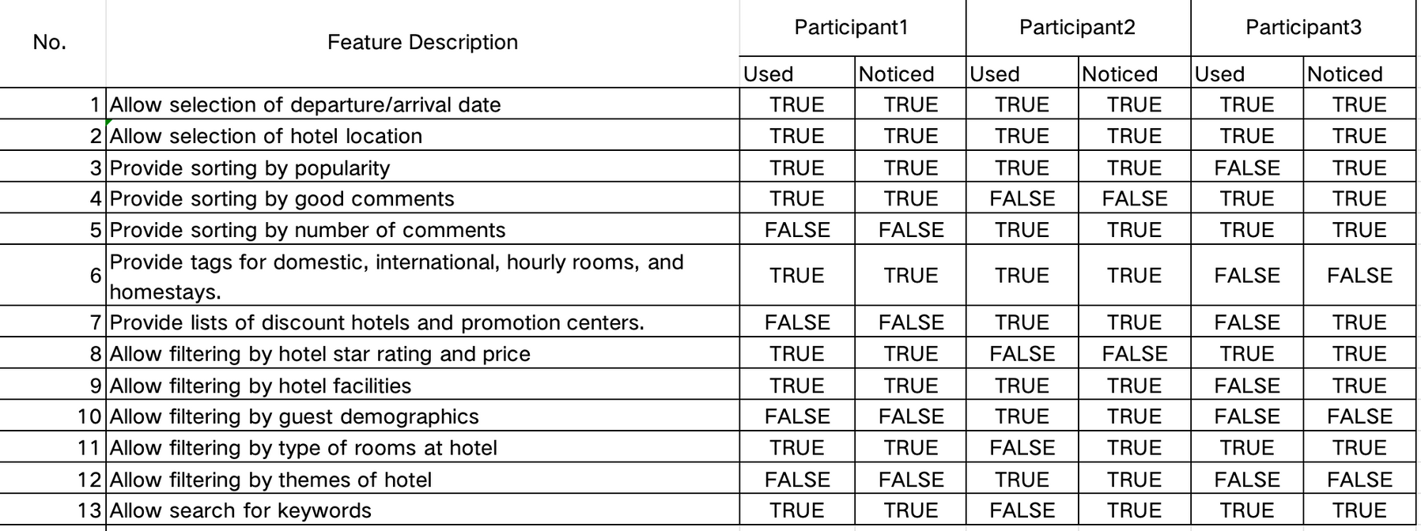
04How to answer questions
(1)Feature checklists(Empirical)
We selected three testers and asked them to make a judgment on the Feature checklists of the system, whether these features are used or noticed.(Quantitative)
Approach to answering questions
Tasks and Data needed
Methods to be used
Report and Results

Slide 17
04How to answer questions
(1)Feature checklists(Empirical)
Approach to answering questions
Effectiveness
The majority of critical features like date selection and hotel location are highly effective, consistently used by participants, indicating clear relevance to user needs.
However, certain features such as sorting by number of comments are less effective, showing lower usage and potential misalignment with user expectations.
Efficiency
Essential functionalities like selecting departure/arrival dates and hotel locations show high efficiency, suggesting these features facilitate quick and straightforward interactions.
In contrast, features like filtering by themes of hotels are underutilized despite being noticed, hinting at possible inefficiencies in design or integration.
Satisfaction
Features that support fundamental tasks such as date and location selections are likely contributing positively to user satisfaction due to their high usage and noticeability.
Conversely, the sporadic use of more complex sorting and filtering options may indicate areas of user dissatisfaction or lack of perceived value.
Tasks and Data needed
Methods to be used
Report and Results

Slide 18
04How to answer questions
(2)Heuristic evaluation(Non-Empirical)
Approach to answering questions
Heuristic evaluation is a method for evaluating the usability of user interface designs. It involves having experts examine a user interface and identify any potential usability issues based on a set of established heuristics or guidelines.
Tasks and Data needed
Methods to be used
Report and Results

Slide 19
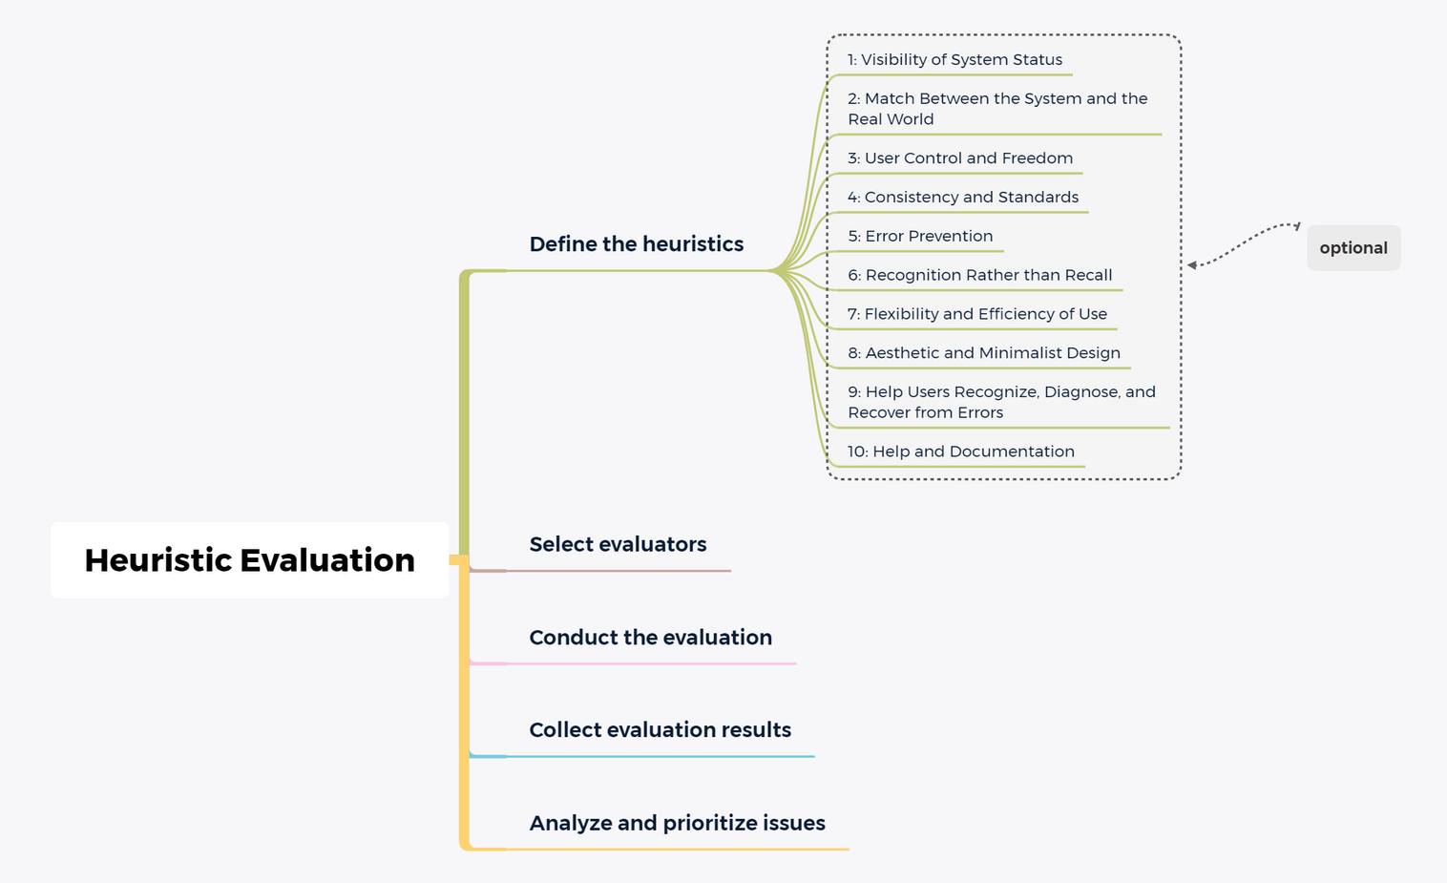
04How to answer questions
(2)Heuristic evaluation(Non-Empirical)
Approach to answering questions
Tasks and Data needed
Methods to be used
Report and Results

Slide 20
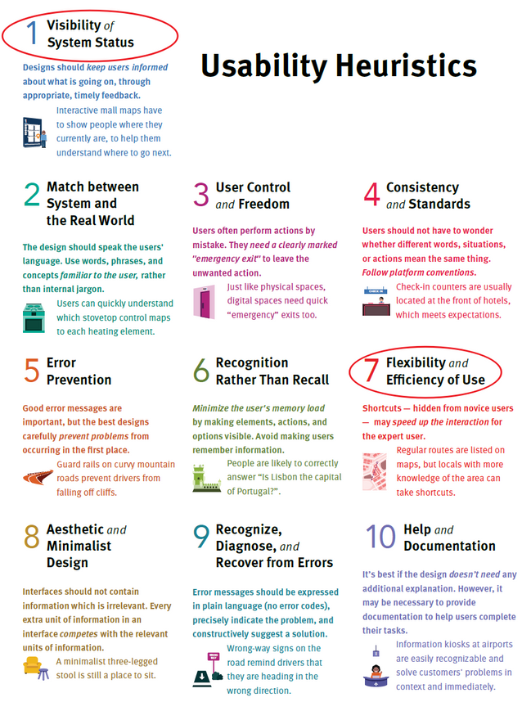
04How to answer questions
(2)Heuristic evaluation(Non-Empirical)
Approach to answering questions
Visibility of System Status
Tasks and Data needed
Flexibility and Efficiency of Use
Methods to be used
Report and Results

Slide 21
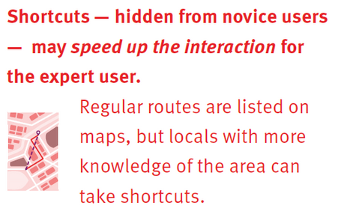
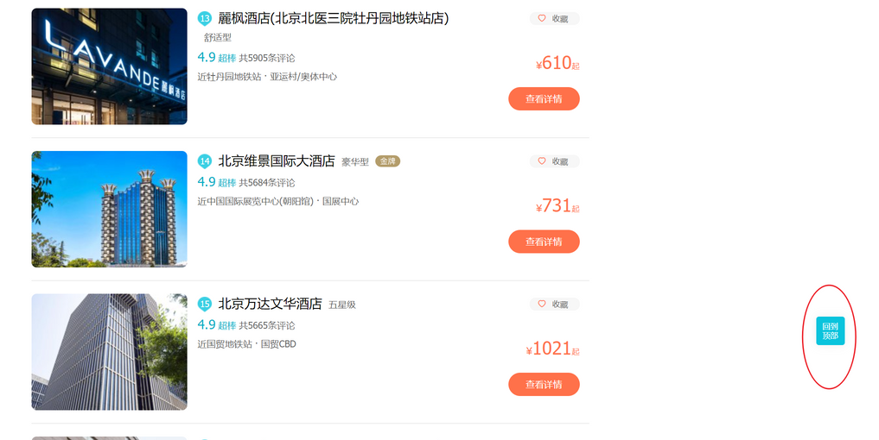


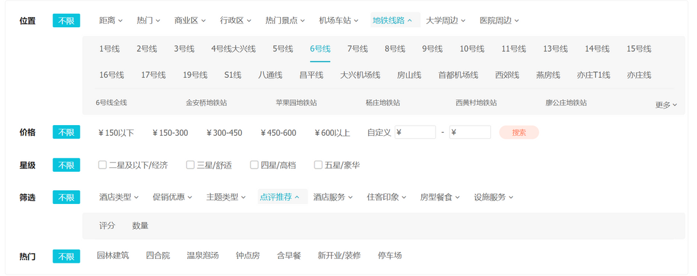
04How to answer questions
(2)Heuristic evaluation(Non-Empirical)
Approach to answering questions
Flexibility and Efficiency of Use
Tasks and Data needed
Methods to be used
Quick Filter Buttons
Report and Results

Slide 22
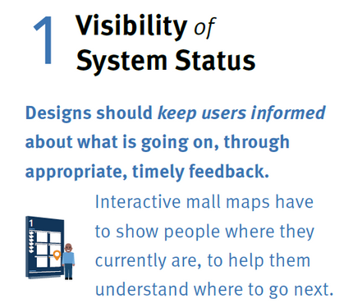
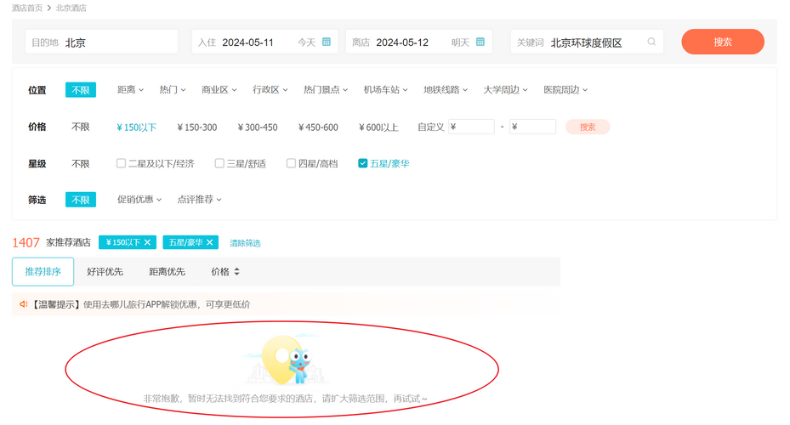
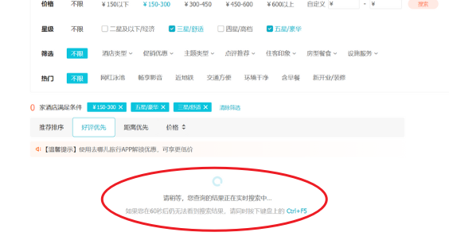
04How to answer questions
(2)Heuristic evaluation(Non-Empirical)
Visibility of System Status
Approach to answering questions
Timely feedback on search results
Lack of filtering range indication
Lack of timer functionality
Tasks and Data needed
Methods to be used
Report and Results
Lack of auto-complete

Slide 23
04How to answer questions
(3)Cognitive walkthrough(Non-Empirical)
Approach to answering questions
Cognitive Walkthrough is a user-centric approach that analyzes user goals and progress to uncover potential issues in the interface design, with the aim of enhancing the overall user experience. It relies on in-depth knowledge and insights about the target users.
Tasks and Data needed
Methods to be used
Report and Results

Slide 24
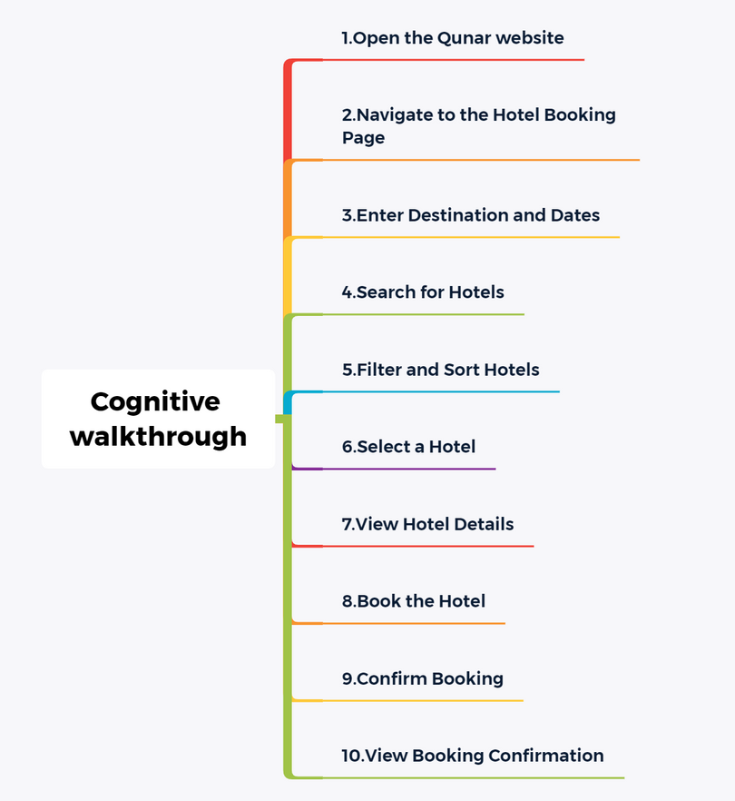
04How to answer questions
(3)Cognitive walkthrough(Non-Empirical)
Approach to answering questions
Tasks and Data needed
Methods to be used
Report and Results

Slide 25
04How to answer questions
(3)Cognitive walkthrough(Non-Empirical)
Approach to answering questions
Identify user goals and tasks
Carefully analyze the users' primary goals and requirements, as well as the specific tasks they need to perform when using the interface.
Understand the users' background knowledge, skill level, and usage habits, as these factors can impact their experience with the interface.
Analyze task completion
Evaluate whether users can successfully complete the expected tasks, and the time and effort required to do so.
Identify the difficulties and obstacles users face at specific steps, and analyze the root causes of these issues.
Tasks and Data needed
Methods to be used
Report and Results

Slide 26
04How to answer questions
(3)Cognitive walkthrough(Non-Empirical)
Approach to answering questions
Can Qunar cater to users with different backgrounds?
— Yes. Qunar offers personalized services for users with different backgrounds. For instance, it provides travel benefits and discounted fares for students, as well as a new user welcome package for first-time app users.
Tasks and Data needed
Can the user see that progress is being made towards their goal?
—Yes, the app provides timely feedback to users about the status of their booking,
such as displaying a summary of the booking details and cost before the final
confirmation.
Methods to be used
Report and Results

Slide 27
04How to answer questions
(4)Incident Diaries(Empirical)
Approach to answering questions
An incident diary is a detailed record of events, incidents, or occurrences that happen within a specific context.
Tasks and Data needed
Methods to be used
Report and Results

Slide 28
04How to answer questions
(4)Incident Diaries(Empirical)
Approach to answering questions
Metrics
1. Observation of frustration and confusion.
2. Subjective measures: people’s perceptions, opinions and judgements.
3. Spontaneous comments.
Tasks and Data needed
Methods to be used
Report and Results

Slide 29
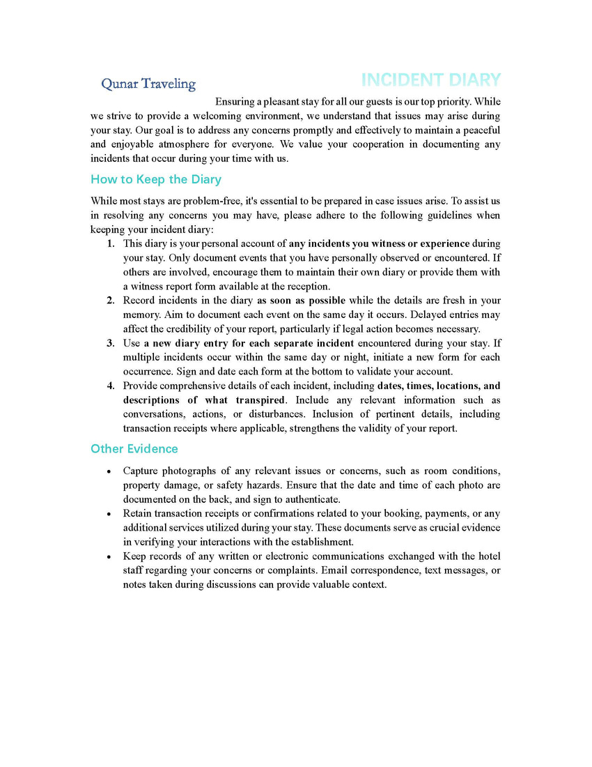
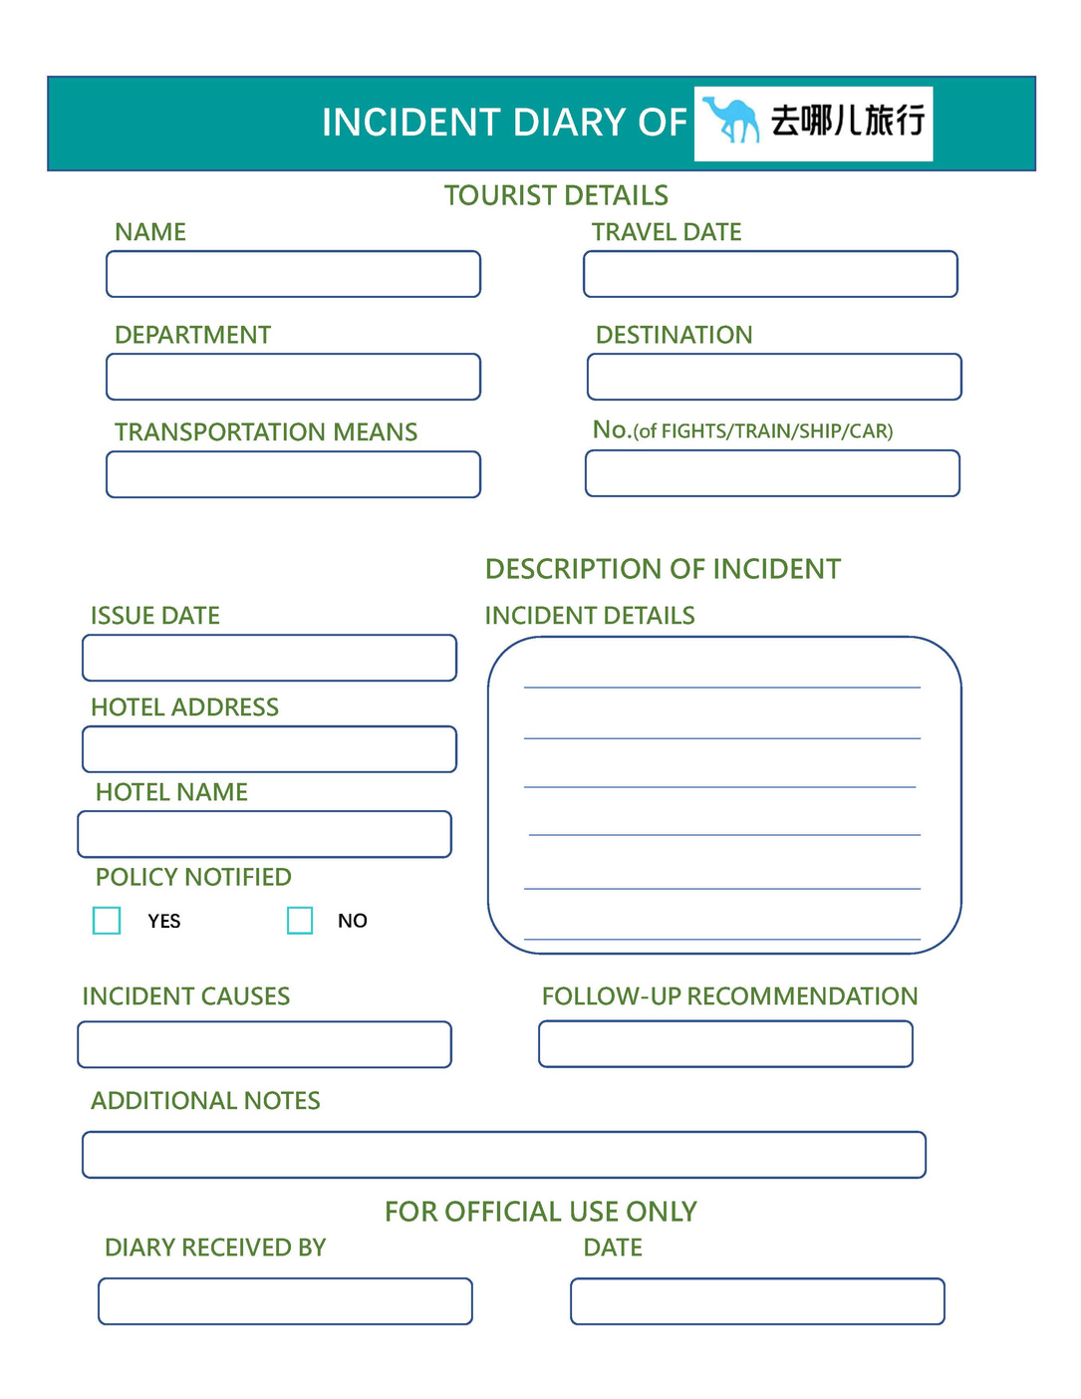
04How to answer questions
(4)Incident Diaries(Empirical)
Approach to answering questions
Tasks and Data needed
Methods to be used
Report and Results

Slide 30
04How to answer questions
(4)Incident Diaries(Empirical)
Approach to answering questions
Identify users’ perception and comments
Analyze the feedback,causes and suggestions,try to summarize the measures taken to handle the incident.
Record of negative feedback
Not judgement,it’s just an obeservation.
Extract the keywords concerning about the negative emotion and perception.
Tasks and Data needed
Methods to be used
Report and Results

Slide 31
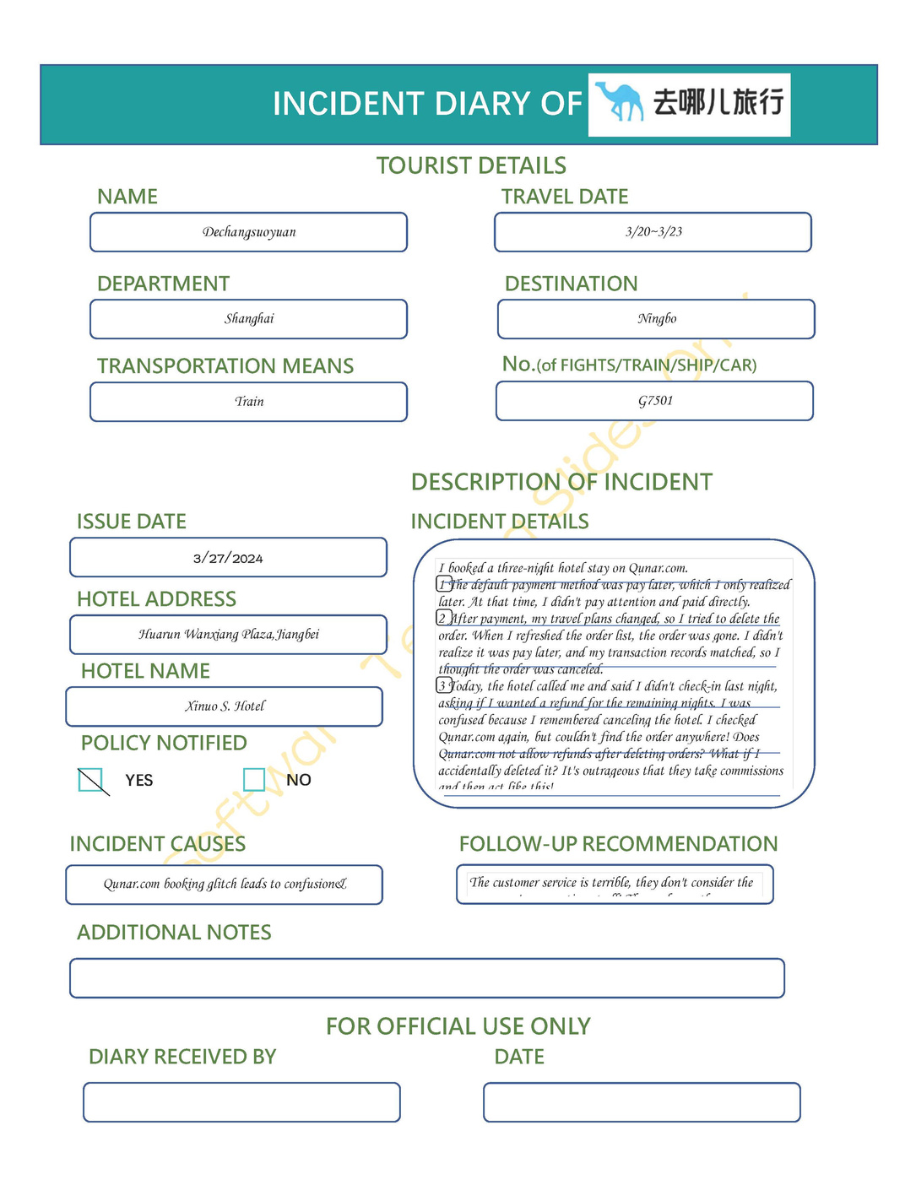
04How to answer questions
(4)Incident Diaries(Empirical)
Approach to answering questions
What’the indicent about?
Payment misunderstanding on booking platform(Low Effectiveness)
Difficulty in canceling order and obtaining refund(Low Effecieny,Not eay to use)
Poor customer service response(Low Satisfaction,Irritating)
Lack of transparency and accountability in platform policies(Not easy to learn)
)
Tasks and Data needed
Methods to be used
Report and Results

Slide 32
04How to answer questions
(5)Field Observation(Empirical)
Approach to answering questions
Definition
Field observation is defined as a qualitative method of data collection that aims to observe, interact and understand people while they are in a natural environment.
Tasks and Data needed
Pros:
Real-world immersion
Comprehensive data collection
Proximity-driven insights
Cons:
Costly and time-consuming
Susceptible to bias
Complex note-taking
Interpretive and subjective
Lack of external variable control
Methods to be used
Report and Results

Slide 33
04How to answer questions
(5)Field Observation(Empirical)
Approach to answering questions
Tasks of Field Observation
1.Build the Right Team
2.Recruiting People for the Study
3.Data Collection Methodology
Could be a mix of surveys, interviews, case studies and observation.
4.Planning a site Visit
Important to the success of the field research
it is always conducted in the actual natural environment of the respondent/s.
5.Data Analysis
6.Communicating Results
Tasks and Data needed
Methods to be used
Report and Results

Slide 34
04How to answer questions
(5)Field Observation(Empirical)
Approach to answering questions
Keeping an ethnographic record is very important
in conducting field research.
Also,there’re 4 field notes,and we chose the 2nd:
Job Notes: Interrupt the respondent and make them not serious
Field Notes Proper:Easy to implement and no interruption
Methodological Notes:
Moniter the progress of any new proposed method
4. Journals and Diaries:too costly and hard to implement.
An insight of the life of the respondent
Tasks and Data needed
Methods to be used
Report and Results

Slide 35
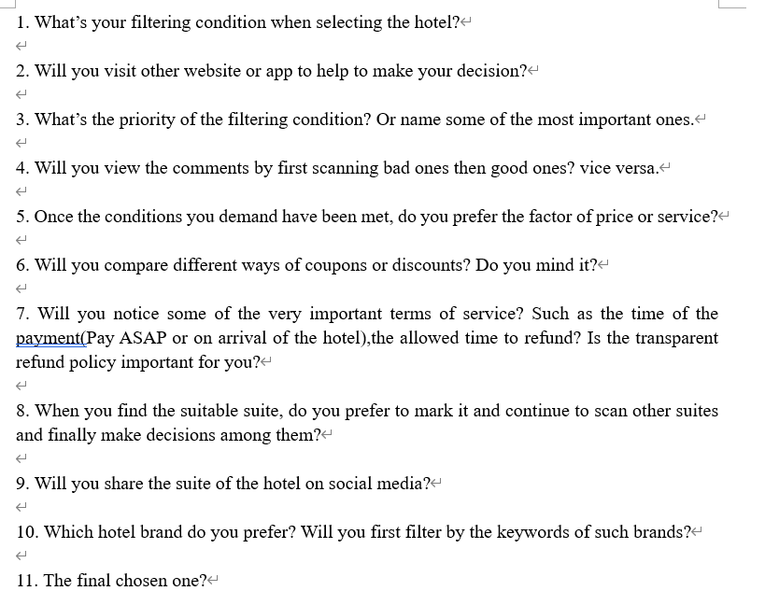
04How to answer questions
(5)Field Observation(Empirical)
Approach to answering questions
Field Notes Proper Template
These notes are to be expanded on immediately after the completion of events. The notes have to be detailed and the words have to be as close to possible as the subject being studied.
Tasks and Data needed
Methods to be used
Report and Results

Slide 36
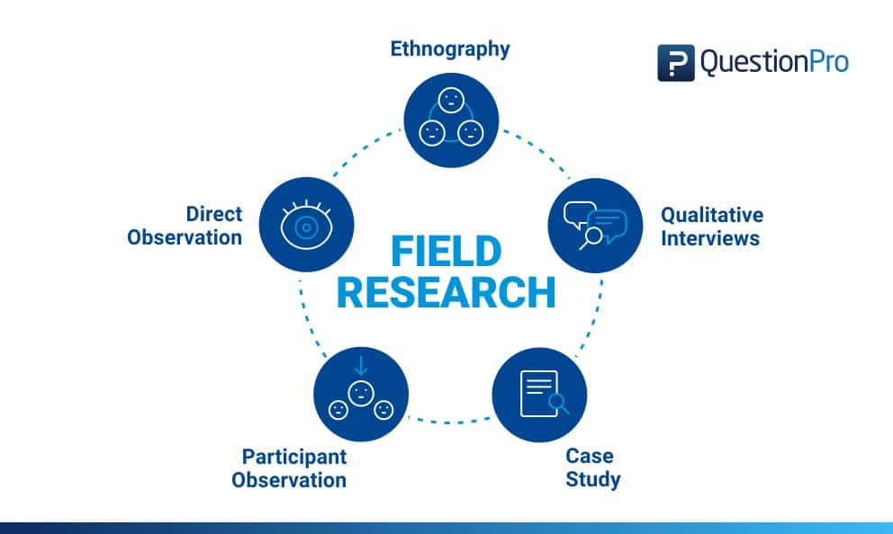
04How to answer questions
(5)Field Observation(Empirical)
Approach to answering questions
Among 5 methods of research,I prefer the participant observation.
Charateristics
Conducted in a natural environment
The researcher gets involved in the discussions
Tasks and Data needed
Methods to be used
Report and Results

Slide 37
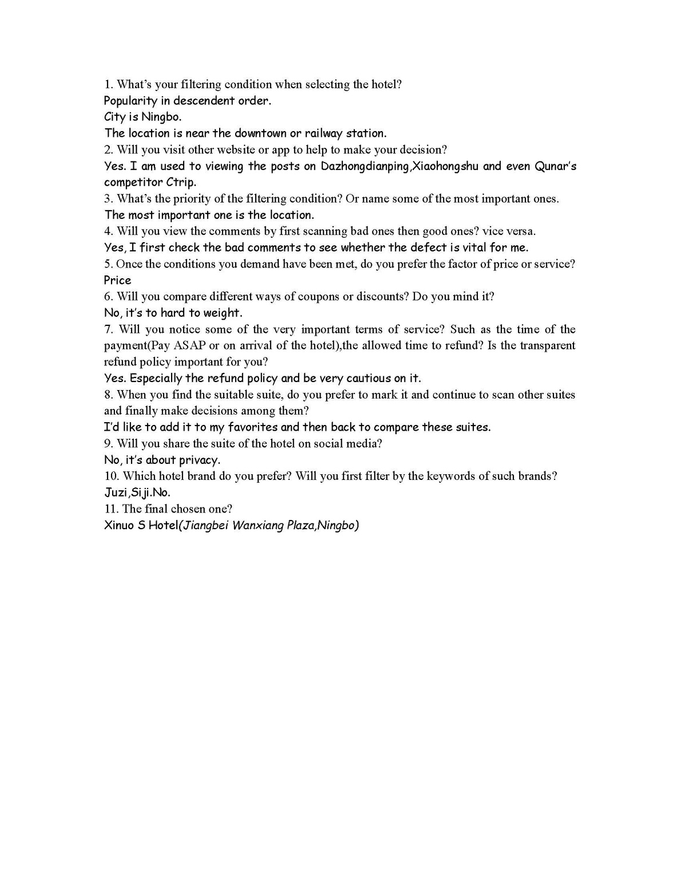
04How to answer questions
(5)Field Observation(Empirical)
Approach to answering questions
What’the indicent about?
The discount rules of coupon is too complicated to compare.(Hard to learn)
The refund policy is obvious(Easy to learn)
Sometimes the transaction is hard to drawback even far before the day.(Low Efficieny)
)
Tasks and Data needed
Methods to be used
Report and Results

Slide 38
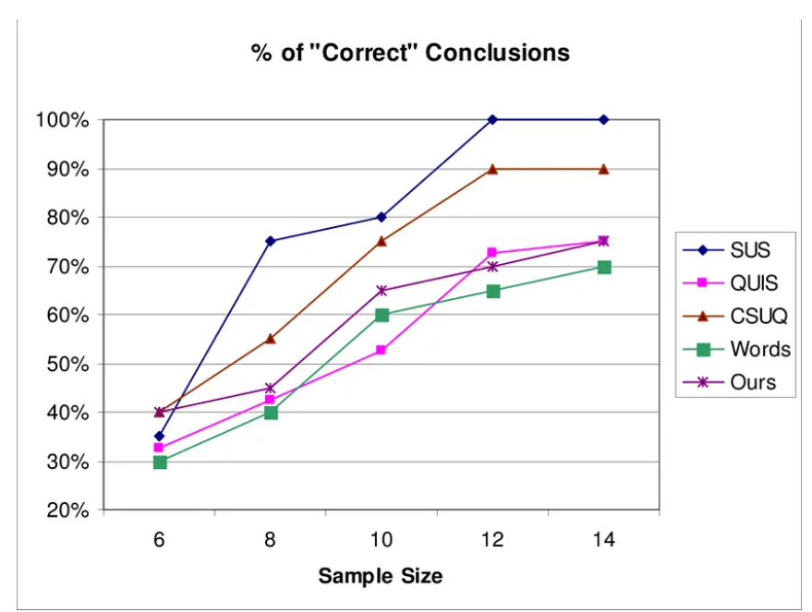
04How to answer questions
(6)System Usability Scale (Empirical)
Approach to answering questions
It consists of a set of 10 questions that cover aspects such as software usability, reliability, and performance. Users evaluate the usability of the software by answering these questions, with higher scores indicating higher software availability.
Tasks and Data needed
Advantage : it's high sensitivity, as it can achieve a 75% correct conclusion rate with only 8 samples, better than QUIS and others.
Disadvantage : the database has not been updated since 2011.
Methods to be used
Report and Results

Slide 39
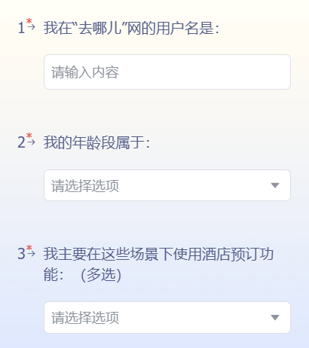
04How to answer questions
(6)System Usability Scale (Empirical)
Approach to answering questions
Use questionnaire method, where users are required to provide their account names (to ensure authenticity)
Tasks and Data needed
Then, we should identify different user groups
Methods to be used
Report and Results

Slide 40
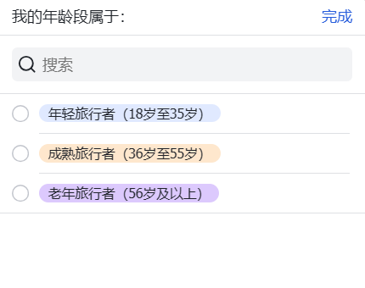
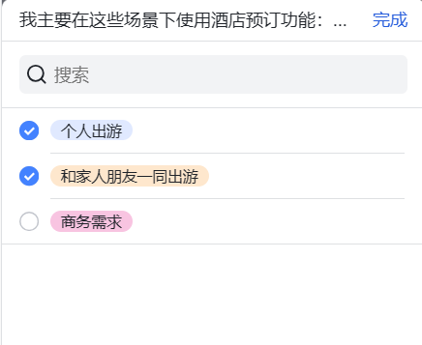
04How to answer questions
(6)System Usability Scale (Empirical)
Approach to answering questions
Users should select their age group and specify their requirements for hotel bookings.
Tasks and Data needed
Methods to be used
Report and Results

Slide 41
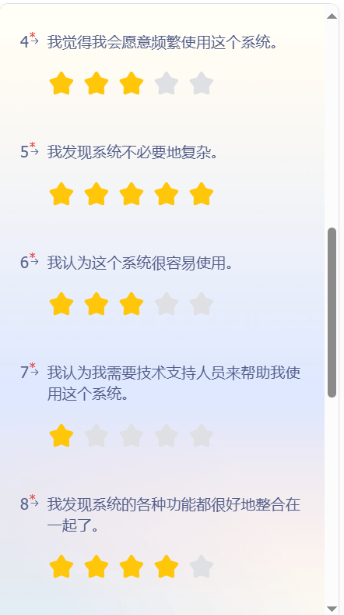
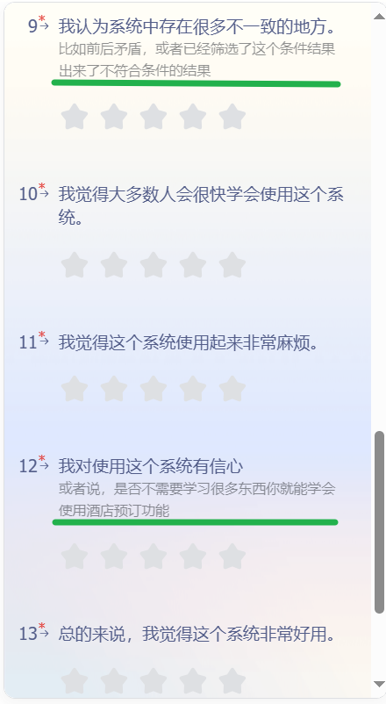
04How to answer questions
(6)System Usability Scale (Empirical)
Approach to answering questions
The Standardized SUS questions:
We have added some suggestive statements to help users understand the questionnaire content
Tasks and Data needed
Methods to be used
Report and Results

Slide 42
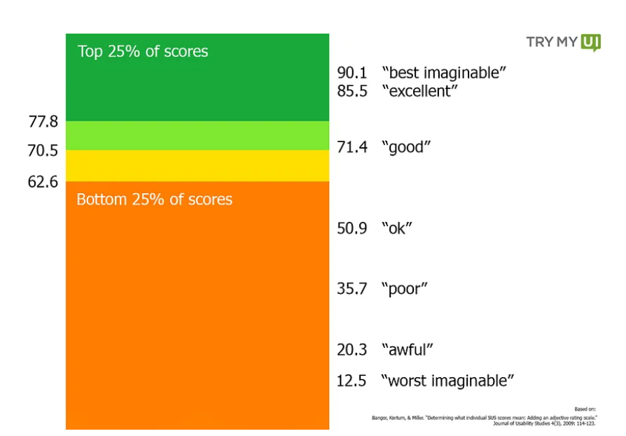
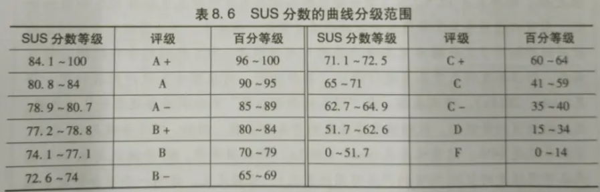
04How to answer questions
(6)System Usability Scale (Empirical)
Approach to answering questions
Scoring rules: For positive properties, if =5, add 4 points; For negative ones, if =0 add 4 points and multiply the final total by 2.5
Tasks and Data needed
Methods to be used
Report and Results

Slide 43
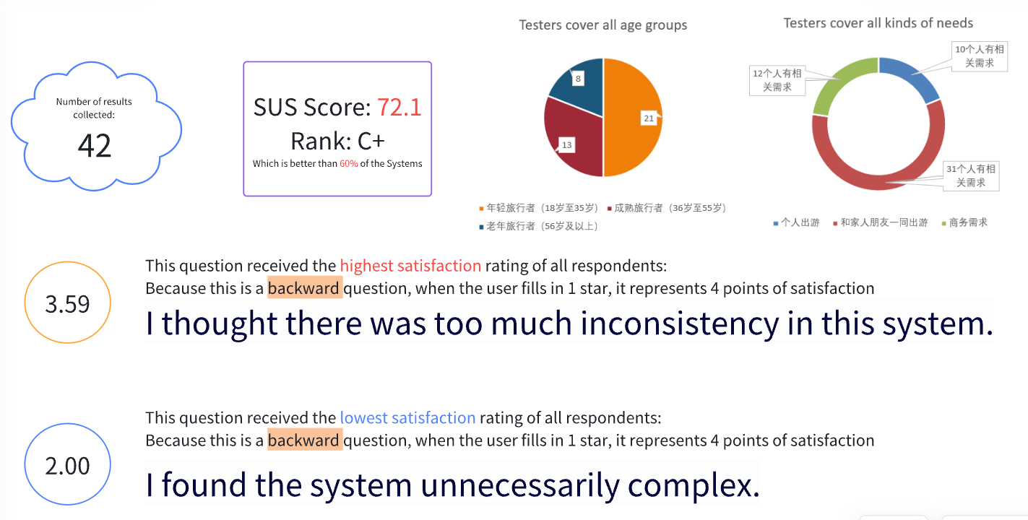
04How to answer questions
(6)System Usability Scale (Empirical)
Approach to answering questions
Overall, the hotel booking system does a good job.
The system has nice consistency, but complexity is too high
Tasks and Data needed
Methods to be used
Report and Results

Slide 44
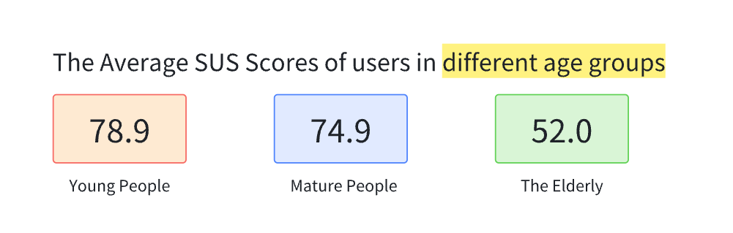
04How to answer questions
(6)System Usability Scale (Empirical)
Approach to answering questions
Across all age groups, the elderly are the least satisfied with this software, probably because it is not user-friendly enough for the elderly, and it does not provide elderly relevant filtering fields
Tasks and Data needed
Methods to be used
Report and Results

Slide 45
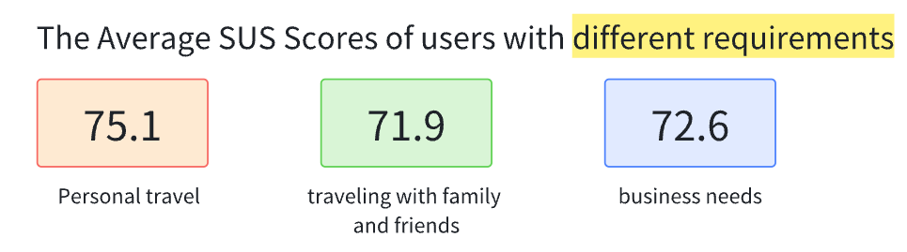
04How to answer questions
(6)System Usability Scale (Empirical)
Approach to answering questions
Across all requirements, the users who want to travel with family and friends has the lowest satisfaction, possibly because their hotel booking needs are not taken into account, such as those needs related to children, those related to the elderly, those related to couples, and those related to holding a party.
Tasks and Data needed
Methods to be used
Report and Results

Slide 46
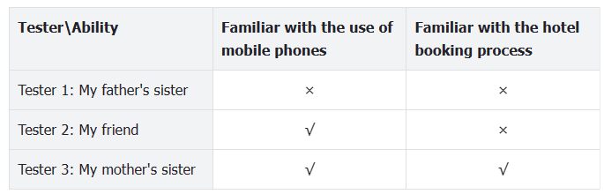
04How to answer questions
(7)Unstructured Interview (Empirical)
Approach to answering questions
It is an unstructured, free talk testing method.
Through unstructured interviews, the attitude data is available, which can be used both to detect errors and to find solutions.
We found the following three users according to whether they were Familiar with the use of mobile phones and whether they were Familiar with the hotel booking process
Tasks and Data needed
Methods to be used
Report and Results

Slide 47

04How to answer questions
(7)Unstructured Interview (Empirical)
Approach to answering questions
My aunt: 60 years old, can not read small words, seldom use APPs
(This image comes from the web)
Advantages:
There are plenty of hotels available. Even near Tiananmen Square, you can find lower-priced ones.
There are many guided questions, and the AI customer service provided by the hotel is very convenient.
My aunt always forget to click confirm, but it will still save the filtering criteria.
Tasks and Data needed
Methods to be used
Report and Results

Slide 48
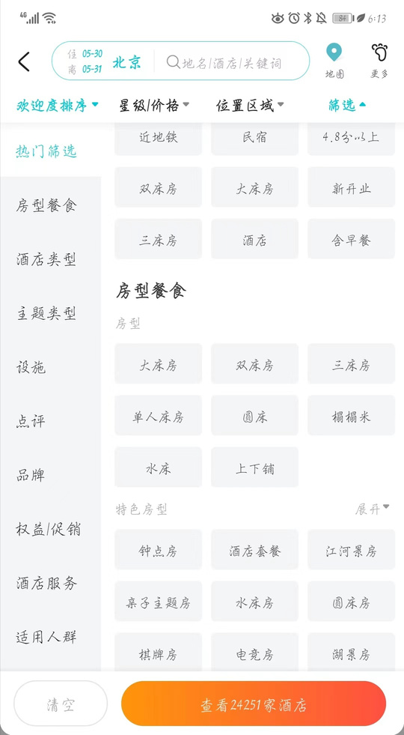
04How to answer questions
(7)Unstructured Interview (Empirical)
Approach to answering questions
My aunt: 60 years old, can not read small words, seldom use APPs
Problems:
Words are too small
Many buttons are unclear on how to operate; my aunt has a fear of making mistakes by clicking them. The interface is too complicated.
Do not know how to return, unable to go back to the previous search
Can’t find the hotel reception phone
No video tutorial
It’s too confusing for the elders
Tasks and Data needed
Methods to be used
Report and Results

Slide 49
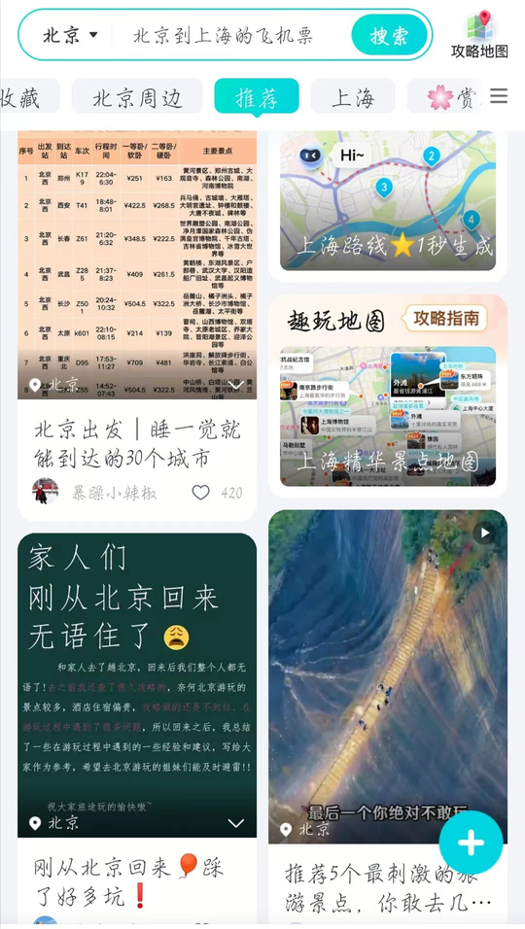
04How to answer questions
(7)Unstructured Interview (Empirical)
Approach to answering questions
My friend: 21 years old, enjoys using electronic devices, has never traveled before.
Problems:
On the Qunar website, there's no guide for booking hotels, so she can only visit other sites to find experience posts.
The homepage is cluttered, and she doesn't like the style; it looks too much like advertisements.
The "会员预订" button on the interface makes she hesitant and creates confusion.
Tasks and Data needed
Methods to be used
Report and Results

Slide 50


04How to answer questions
(7)Unstructured Interview (Empirical)
Approach to answering questions
My friend: 21 years old, enjoys using electronic devices, has never traveled before.
Problems:
The response time for switching interfaces is long, and she noticed that when filtering by conditions, it refreshes every few seconds instead of updating immediately.
Some user reviews seem repetitive, raising suspicions of fake reviews, like these two.
Tasks and Data needed
Methods to be used
Report and Results

Slide 51
04How to answer questions
(7)Unstructured Interview (Empirical)
Approach to answering questions
My friend: 21 years old, enjoys using electronic devices, has never traveled before.
Advantages:
Offers a wide range of filtering options.
Provides various sorting methods, including sorting by price from low to high, a feature some e-commerce platforms used to intentionally avoid.
Convenient access to browsing history.
Offers coupons for new users.
Can be shared with friends for voting assistance.
Allows filtering to only display negative reviews, reviews with images, or viewing the latest comments.
Suggestions:
‘Check-in and check-out times’ should be placed in a more prominent position.
Tasks and Data needed
Methods to be used
Report and Results

Slide 52

04How to answer questions
(7)Unstructured Interview (Empirical)
Approach to answering questions
My aunt: 45 years old, has two children and often takes them out for trips. She doesn't care much about the price, because she believes that her children's happiness is more important.
Advantages:
All devices I need are in the filter options, such as whether cooking facilities are available, if there's a washing machine, and whether there are children's play facilities. Additionally, it can filter out new hotels and hotels that provide robot meal delivery services. It can also filter out chain hotels.
These are the filters I usually choose.
Tasks and Data needed
(This image comes from the web)
Methods to be used
Report and Results

Slide 53
04How to answer questions
(7)Unstructured Interview (Empirical)
Approach to answering questions
My aunt: 45 years old, has two children and often takes them out for trips.
Disdvantages:
Unable to search keywords within reviews, you can only view them one by one.
There are too many filtering options, making it cluttered. I suggest separating children-related content for easier retrieval.
When filtering for new establishments, the opening hours are not indicated on the page. I'm concerned that if a hotel has been open for less than half a year, it might have formaldehyde（甲醛） inside.
Tasks and Data needed
Methods to be used
Report and Results

Slide 54

04How to answer questions
(7)Unstructured Interview (Empirical)
Approach to answering questions
Suggestions:
When browsing through comments, my aunt noticed that some other parents were posting pictures of their children, similar to posting on social media. She actually felt concerned for them when she saw this. My aunt believes that the platform should help protect users' privacy and remind them not to upload pictures of themselves.
Tasks and Data needed
Methods to be used
Report and Results

Slide 55
04How to answer questions
(7)Unstructured Interview (Empirical)
Approach to answering questions
Overall, through the unstructured introduction, we have identified the following areas that need improvement:
Effectiveness(Contact customer service), Efficiency(Return searching results), Safety(Information privacy protection), Utility (Reliable comments), Learnability(Get-started document and Clear interface)
We found that the advantage of using the unstructured introduction survey method is its flexibility, allowing for a deeper exploration of respondents' viewpoints, experiences, and emotions.
However, its drawback is its low efficiency and the limited number of samples obtained. If we were an actual testing team, using only this feedback would not be sufficient to request changes from the development team.
Tasks and Data needed
Methods to be used
Report and Results

Slide 56
Thanks For Watching !
Advised by Prof.Qin Liu
Group 16:
2151409 Yuntao Hu
2152085 Yifei Sun
2054099 Jieying Ye
2152193 Yixin Li

